Slide 1
Why early language development is so important
Notes:
The focus of this presentation is on language development as a first step towards building learning and early literacy.

Slide 2
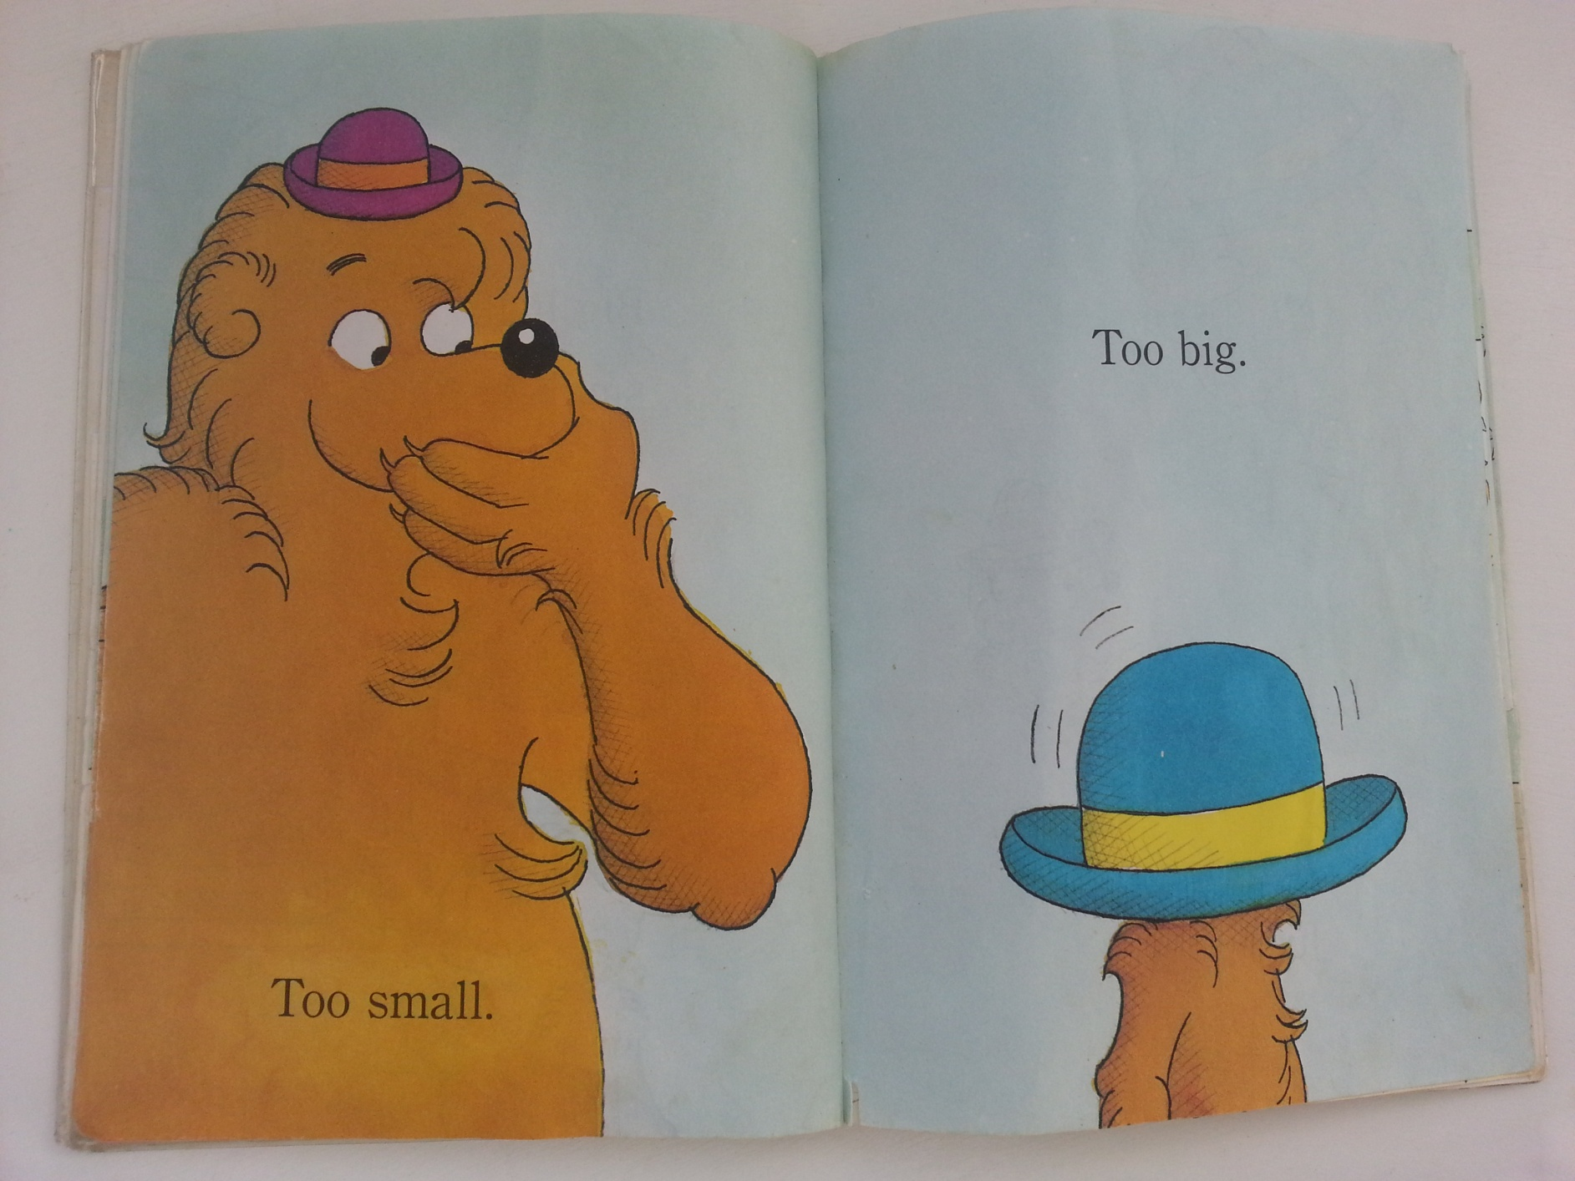
When children learn to read, some words can be sounded out …b-i-g...big
But children don’t only read by sounding out …

Slide 3
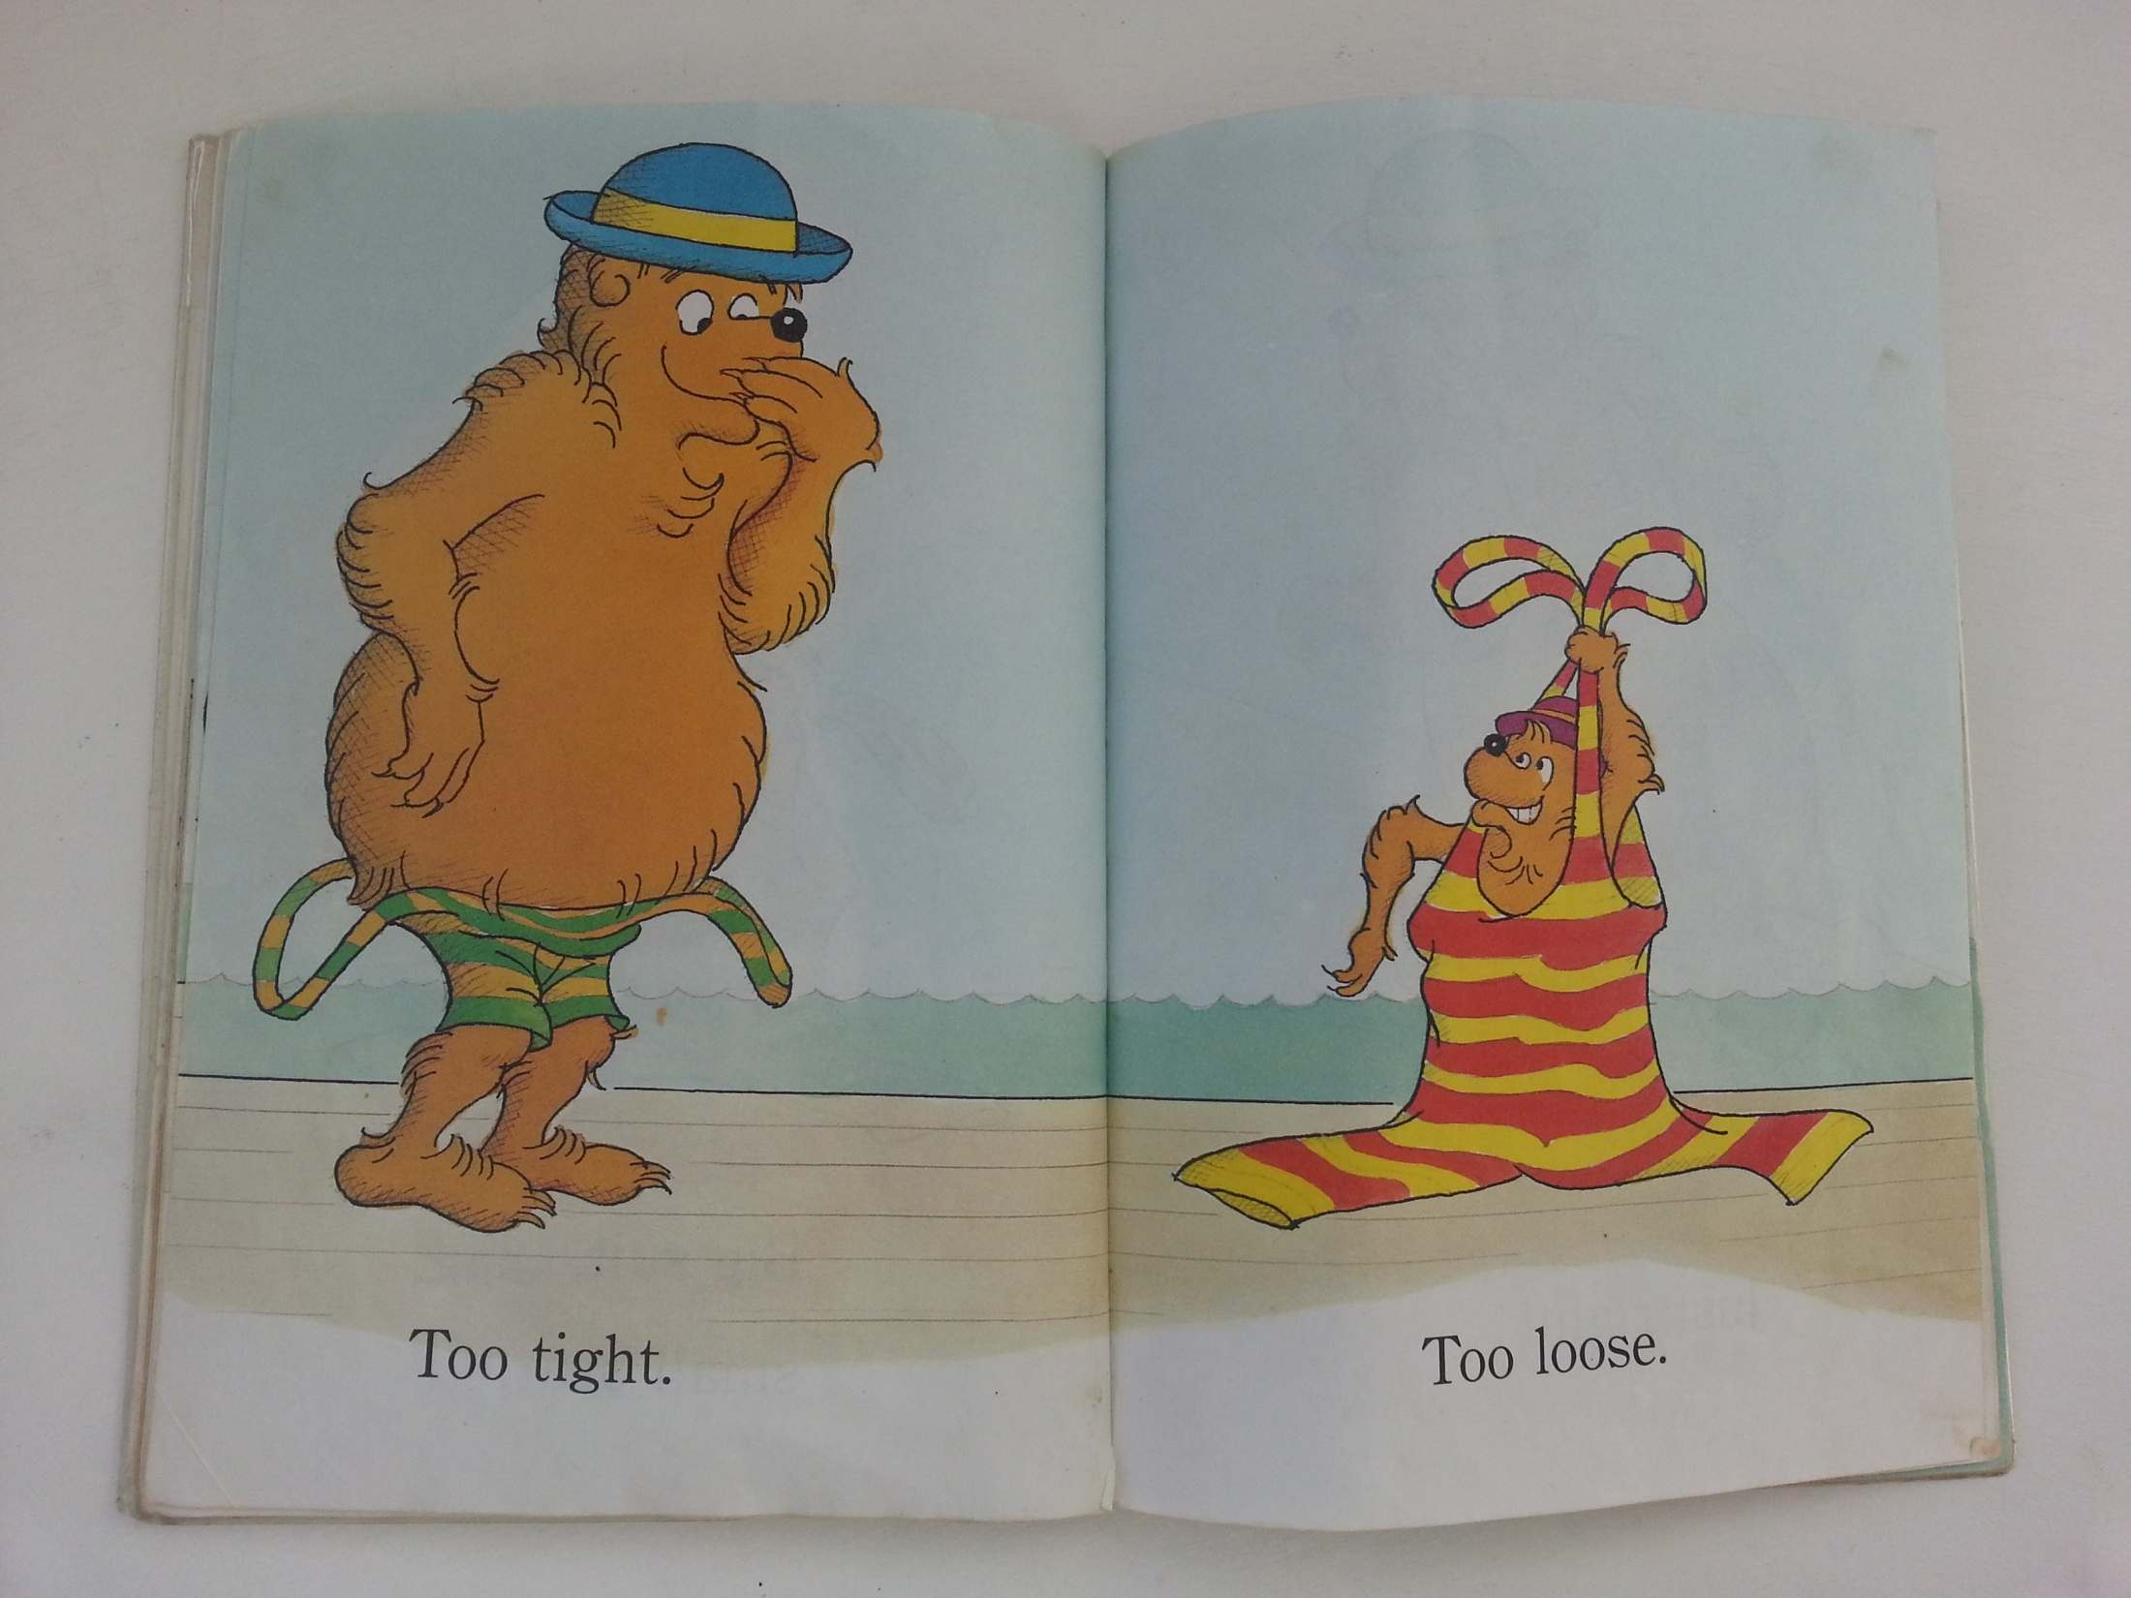
Children look at pictures and predict what words say
They can only do this if they know the meanings of words – language is key!
Notes:
Sounding out the word ‘tight’ (t-i-g-h-t) doesn’t sound the same as the pronunciation of ’tight’ . So children will look at the picture, and make sense of it based on their own experience of getting dressed - putting on clothes that are too tight or too loose – it is helpful if they have heard these words before. They may have used the words too big or too small again if they haven't been exposed to the new words.

Slide 4
So good language helps children predict what words say, but most importantly, it ensures that they understand what they read!
Notes:
If they have carried shopping bags that are heavy and light, they will link that experience to words in this picture

Slide 5
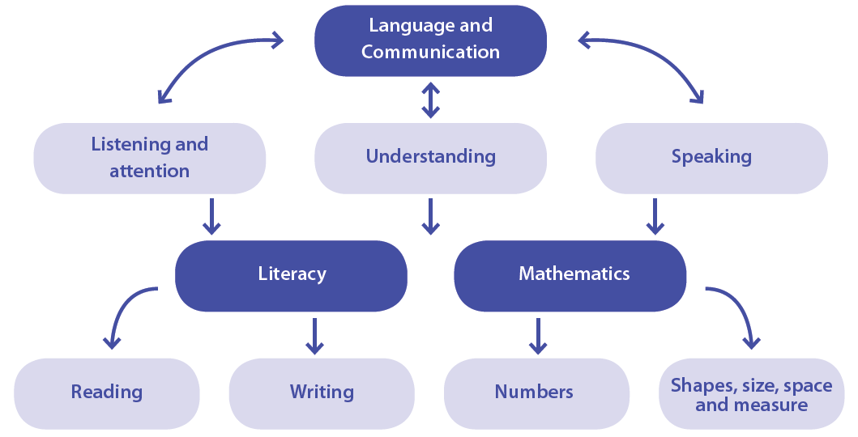
all
The essential role of language in early learning
Notes:
For good communication we need to listen and pay attention, understand what people are saying to us and be able to speak out thoughts. If all of that is in place then school will be easier because we learn literacy and mathematics through language and communication. So much of what children have to do in school is language based and so their success is dependant on how good their ability with language is.

Slide 6
Why early language matters
Studies have found:
Children who get higher scores on vocabulary tests at age five tend to score better on reading comprehension tests in Grades 3 and 4
Children who score poorly on reading comprehension in 5th grade had the lowest scores on assessments of language at 4 ½ months, 15 months, 2 years and 3 years

Slide 7
Research shows: there are very big differences in children’s early language development
Hart and Risley (1995) followed children from 9 months to 3 years.
By the time they were three years old, some children had heard 45 million words, while other children had heard 13 million words.
32 million word gap
Notes:
Groundbreaking study done in the USA in the 1960s to try to understand why children from families living in poverty did not achieve the same academic results as children from working class and professional families.
Tape recorders were placed in homes of families from these three groups over a few months and researchers found out a few very important things: (i) children from families who are on social grants are spoken to far less than children whose parents are professionals, eg doctors, lawyers, etc. (ii) these children also didn’t get the same types of words (they heard mostly business talk), and (iii) professional parents reprimanded their children, but far less than parents who received social grants - more than double the amount of negative remarks made to children in poor families compared to those in professional families.

Slide 8
children who hear more words
higher scores on vocabulary tests at age 3
higher scores on vocabulary and reading comprehension tests at age 9

Slide 9
Not only a difference in the amount of words children heard, but also the kinds of words they heard.
Stop that!
Eat your food.
Time for bed!
Come here.
Notes:
This is called ‘business talk’ in families. What type of language is this? Instructions, short commands, but no conversation! This kind of language actually blocks off communication and focuses mainly on managing children's behaviour.

Slide 10
More stories, explanations, varied vocabulary, back and forth conversations and loving words
Remember when we went to visit Ouma….
I am sure that made you feel disappointed.
That is a great idea – I love your thinking!
That word ‘enormous’ is a hard word … it means very, very big
What a good try!
Notes:
Ways of talking:
Sharing personal stories
Describing feelings
Loving words – affirming and encouraging
Explanation
This leads to a rich language experience for young children.

Slide 11
How can we make sure all our children have the benefit of rich early language learning experiences and loving words?

Slide 12
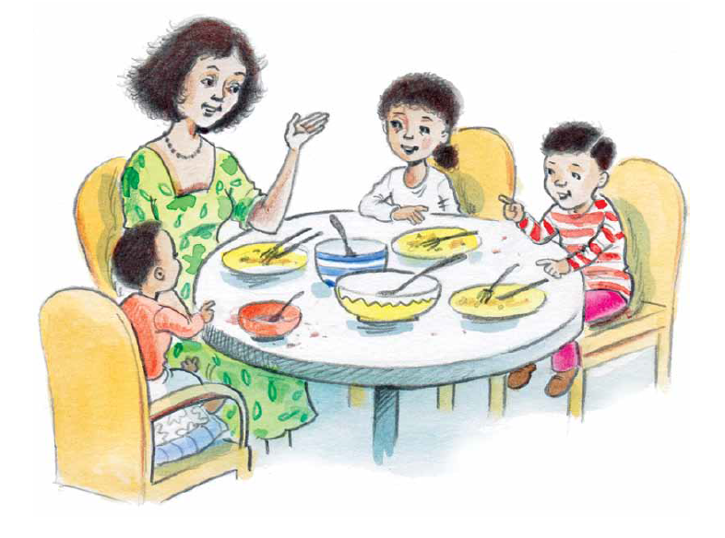
Early language matters
(Lucchese and Tamis-LeMonda, 2007)
Notes:
Parents, significant caregivers, childcare providers and ECD practitioners have a very important role to play in preparing children for school and can change what happens in a child’s life! These interaction encourage developing language skills and provide a strong foundation for academic achievement. Learning in this way is not based on the curriculum – using flash cards, repetitive, rote learning where everyone chants together. We often think learning is when we are drilled but other ways of learning are often more impactful.

Slide 13
Talk and listen
Notes:
How is this care giver helping the child develop good language? She affirms what the child is saying and uses correct language (Yes, that’s a chicken and the mommy is called a hen). She also adds more information and words (rooster).

Slide 14
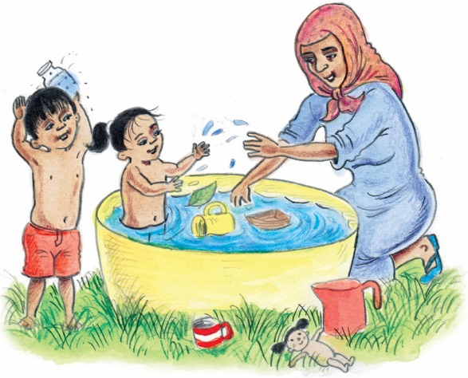
Notes:
This type of play is happening in pre-schools. But do we add language to accompany the activities the children are engaged in? Playing with water, sand, building, making puzzles are opportunity for children to learn new words. (Ask the audience): What words do you think your practitioners could use during water play? (float, sink, deep, clod, splashing, empty , pour, full)

Slide 15
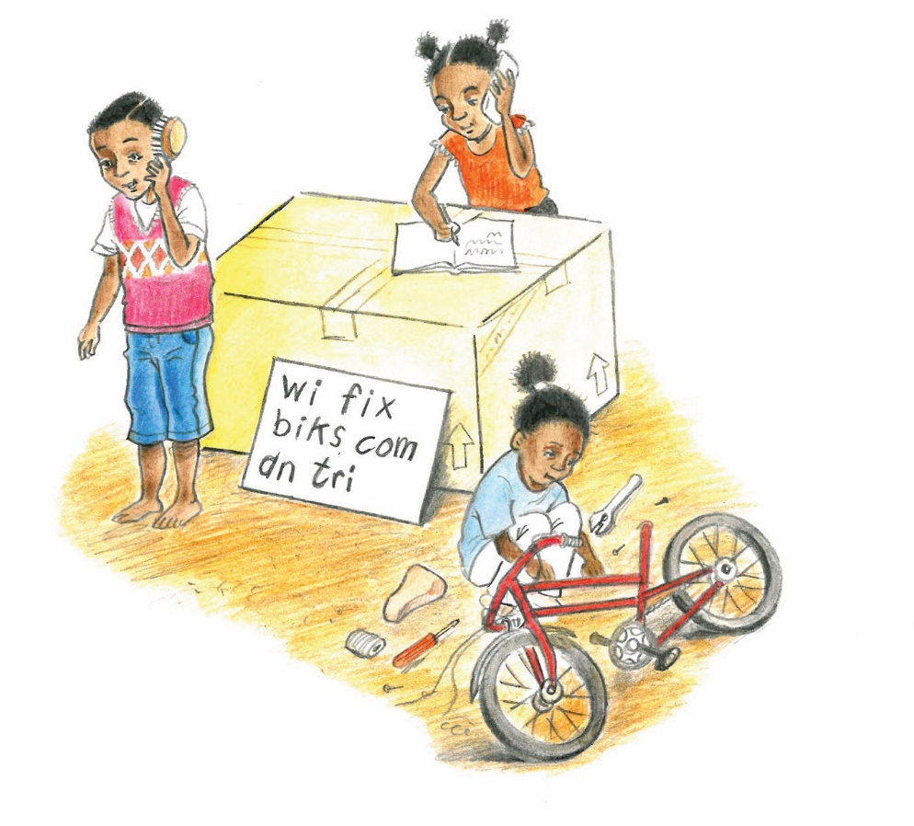
Notes:
Pretend play – or fantasy corner. Children have to take on roles during pretend play, they use language to explain and describe things – this requires a different level of language than that used in everyday interactions. These children are using their imagination.

Slide 16
Tell stories
Notes:
Children love to hear stories over and over. They can be encouraged to add to the story.

Slide 17
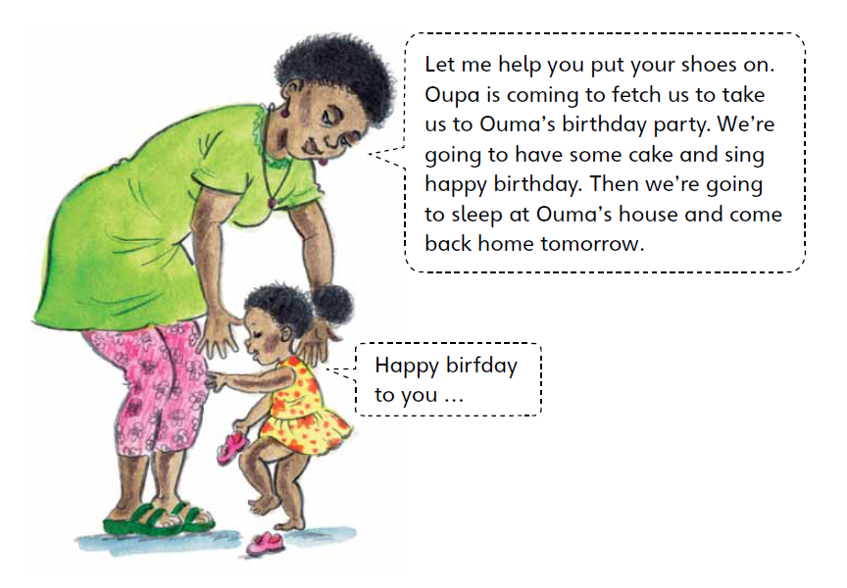
Notes:
This a story about what is going to happen – we call this ‘talking forward’. The little girl knows that when it is someone’s birthday we sing ‘Happy Birthday’ and she is trying it out –even though she can’t say the words perfectly.

Slide 18
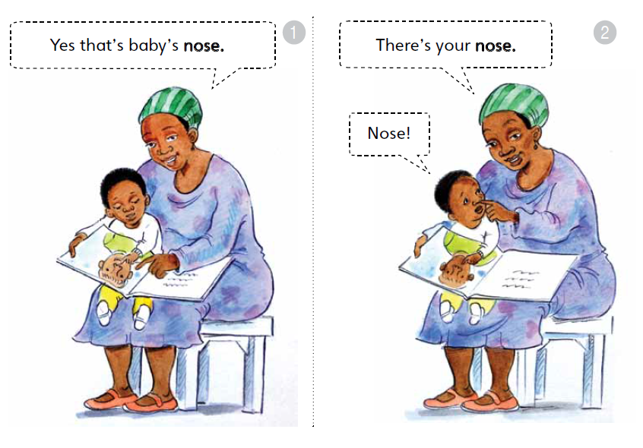
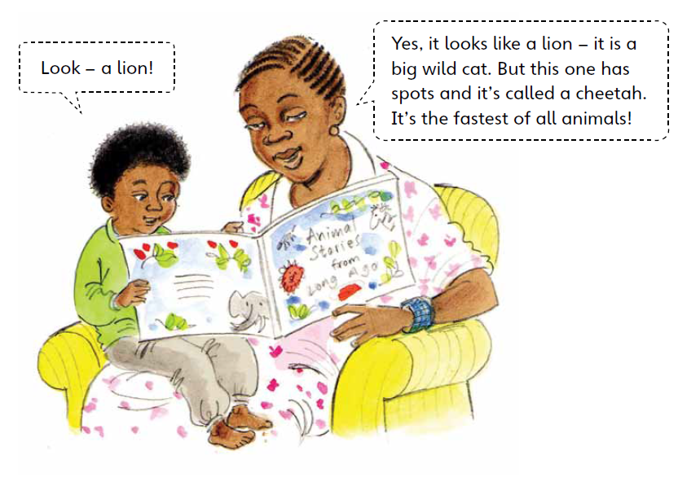
Notes:
Adding more words – the mother is correcting her son, but she does it in a very kind way – giving him the correct name of the animal and also giving him more information about the animal. Lots of learning happening here.

Slide 19
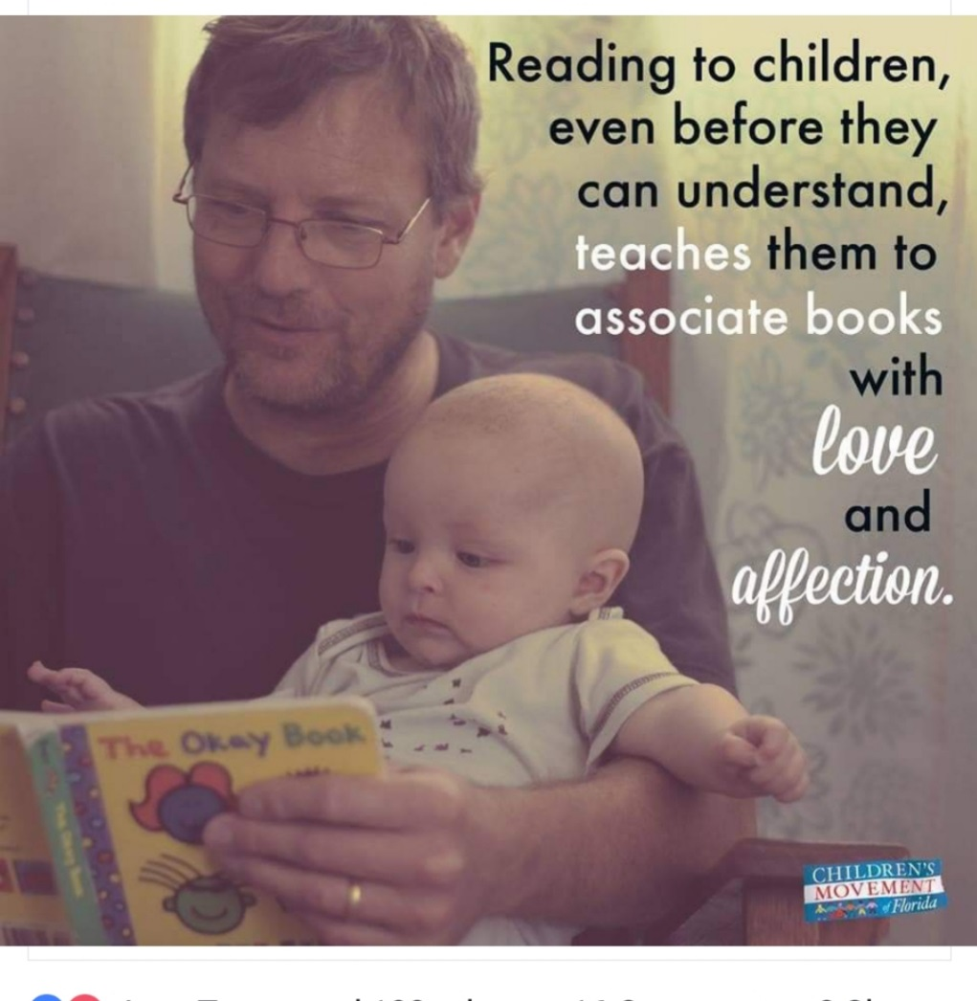

Slide 20
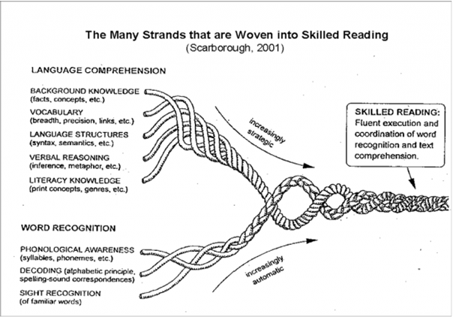
Notes:
The rope can only be strong if all the strands are strong. Most of us think that reading involves word recognition but that is only the part of reading that is done at school. RSRW games address all of these areas too. If children don’t understand what they are reading then they are only ‘barking at print’ so we need to use the time during talking and doing to strengthen children understanding. (see notes)

Slide 21
One key way to support children’s writing is the development of their orality…the art of telling a story – a narrative’(S Menon 2018)
Share your own stories and listen to theirs with fascination.
Are they telling you too little? Say “Tell me more!”
Are they telling you too much? Summarise for them and say “How did it end?”

Slide 22
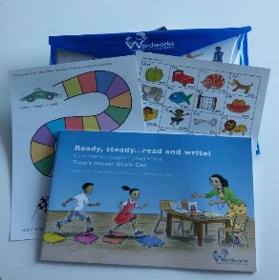
Plan, plan, plan your lessons!
It is important to plan the Talking and Doing step for each lesson:
Decide which book to use and take it home
Think about what kind of props you can bring
Look through the book and think about the kinds of strategies you can use to start a conversation.
Think about new what new vocabulary you can introduce

Slide 23
Early means early!
https://youtu.be/apzXGEbZht0
Notes:
This clip shows us how the way we interact with our babies contributes to their well being. Research ahs shown that children who have care-givers that respond to thme positively will do well academically. In the Ready Steady Read Write programme we put a lot of emphasis on treating the children with love and a positive attitude. This clip shows so well how distressing it is for young children when they receive no response.
Research has also shown that baby programme as only successful when parents interact with them while doing the programme. In other words, TV and digital programmes function best as ‘talking books’ rather than substitutes for parents-child interaction.

